Slide 1
Safe Dance practice: Enhancing the dance experience
Edel Quin, Sonia Rafferty & Charlotte Tomlinson

Slide 2
About the authors
Collectively the authors have more than 60 years experience in the dance profession as creative artists, teachers and researchers, in educational, recreational, and professional settings.
As graduates of the Masters in Dance Science at Trinity Laban Conservatoire of Music and Dance (London), active members of the International Association for Dance Medicine and Science (IADMS), and key personnel for Safe in Dance International (SiDI), the presenters have an international reputation for advocating for research-informed healthy dance practice.
Their recent publication Safe Dance Practice: An applied dance science perspective (published by Human Kinetics) is the culmination of their collective experience researching and applying dance science principles to practice.

Slide 3
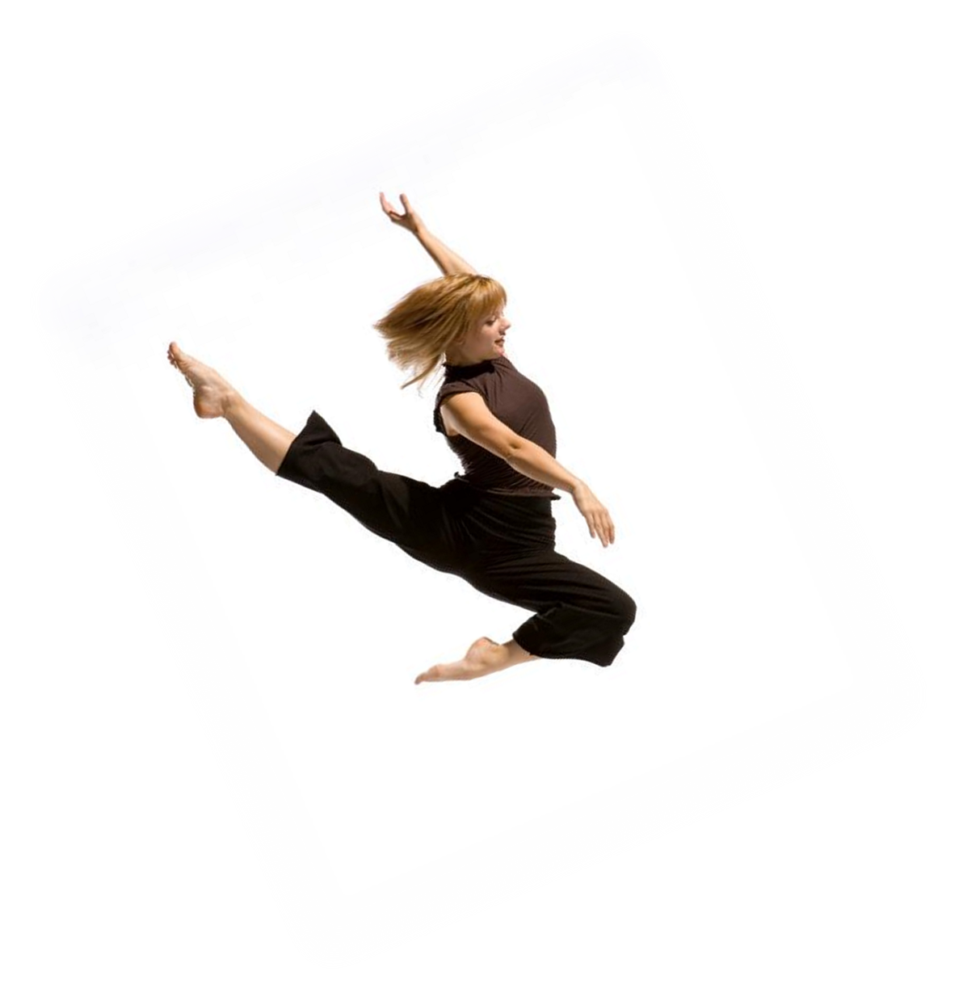
Overview
What is Safe Dance Practice
Multidisciplinary Approach
Incorporating Safe Dance Practice into your
dance experience
Photo: Chris Nash
Dancer: Chloe Stone

Slide 4
The mission
Every dancer regardless of age, experience, ability and style should be able to engage fully in the act of dancing without risk of harm to the body or mind, while also being supported to achieve their full potential.
Quin, Rafferty & Tomlinson, 2015, p. xvii

Slide 5
What safe dance practice is
While Safe Practice does encompass some legislative requirements, it is MUCH more than this!
Progressing what is possible….
“Truly effective safe practitioners will be able to realistically challenge current physical boundaries and push the potential of both the individual dancer and the art form without negatively affecting the dancer’s wellbeing or the artistic product”
(Quin, Rafferty, Tomlinson, 2015, p xx)

Slide 6
Safe dance practice – what and why?

Slide 7
Injury
‘In research reporting the percentage of dancers injured out of a studied sample, the range was 42%−97% across a variety of genres and skill proficiencies’ (Russell 2013: 200)
60-75% of all dance injuries are due to overuse (Potts & Irrang 2001, Thomas & Tarr 2009, Russell 2013)
Photograph: Sonia Rafferty
Dancer: Emily Rutherwood

Slide 8
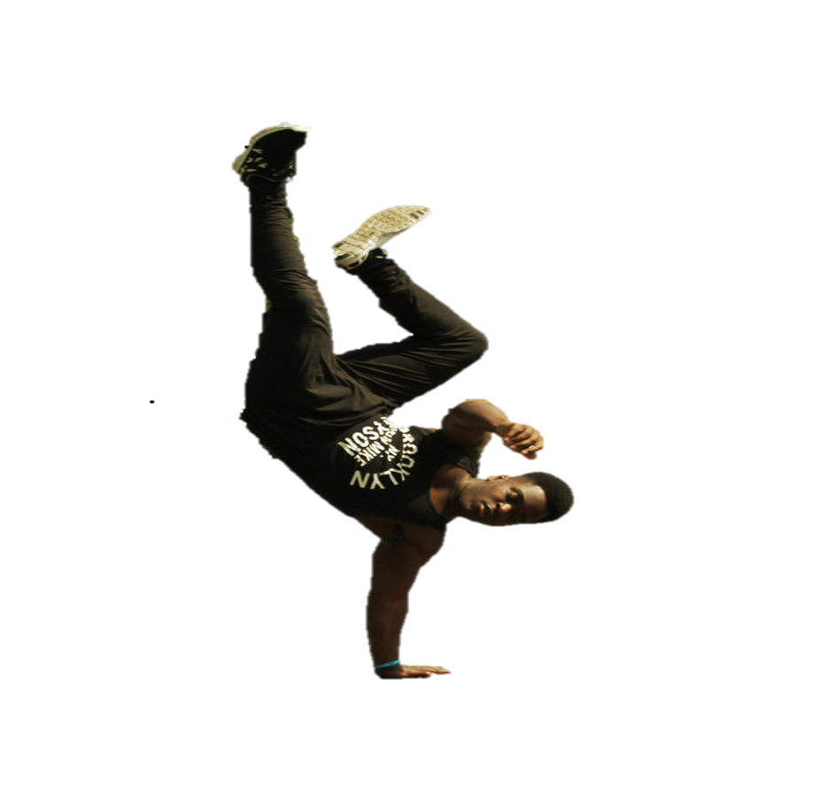
Dance uk: fit to dance 2 Laws, H. (2005)
Common types of injury
Muscle (approx 50%)
Joint (approx 35%)
Tendon (approx 22%)
Bone (approx 20%)
Common locations of injury
Lower back (approx 40%)
Knees (approx 30%)
Ankles (approx 30%)
Feet (approx 20%)
Perceived causes of injury
Overwork (approx 32%)
Fatigue (approx 28%)
Repetitive movement (approx 22%)
Psychological factors (Laws, 2005, Kenny et al 2015, Quin et al 2015)
Photograph: Paula Walker
Dancer: Hakeem Raheem

Slide 9
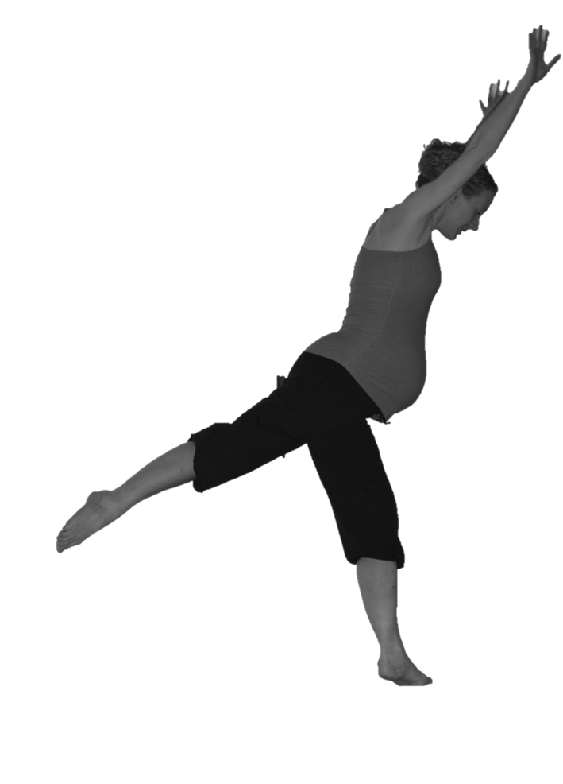
Safe Practice requires..
A multidisciplinary knowledge and understanding of the workings of the human body and mind as applied to:
the individual dancer
the specific context or setting
the specific genre
Photograph: Niamh Morrin
Dancer: Edel Quin (and bump)

Slide 10
Quin, Rafferty & Tomlinson, 2015, p. xviii

Slide 11
Interrelated areas - reality
(Quin, Rafferty & Tomlinson, 2015, pxix)

Slide 12
Putting it into practice
The dance session
Beginning – preparation
During – consider sequencing and progression (structure, content and delivery)
Ending – recovery and evaluation
Context – purpose, practice environment and the participants themselves

Slide 13
Common misconceptions 1
Warm-up means -
doing some “cardio”
conditioning or strength exercises
Photo: Fotolia.com/Dragon Trifunovic

Slide 14
Common misconceptions 2
Warm-up means –
stretching the body to full range to gain more flexibility
frequently dancers’ preferred and default option!
Photo: ©Photoshot/TIPS

Slide 15
Common misconceptions 3
Warm-up means –
style-specific vocabulary taught at the beginning of the class.
Photo: ©XINHUA/Photoshot

Slide 16
Beginning the dance session

Slide 17
During the dance session

Slide 18
Ending the session
Common practice
Energy requirements
Time
Energy requirements
Preferred practice
Time
Notes:
18

Slide 19
Ending the dance session

Slide 20
Knowing your dancers
Areas of key importance are: ‘Differentiation between learners, adaptation due to level of ability and physical needs, and overall considerations regarding individual experience, characteristics, and physiological and psychological development’
(Quin, Rafferty & Tomlinson 2015:198)

Slide 21
Knowing your dancers
The key principles of Safe Dance Practice apply to any dance setting.
What to include and how to manage the dance session depends on the purpose, the environment and the participants themselves.
Personal reflection is key to assessing how well the dance leader met the needs of their participants.
Photographer: Andy Sunbeam
Dancers: Foot in Hand Dance Company

Slide 22
Interrelated areas

Slide 23
Key text…
Quin, Rafferty, Tomlinson (2015). Safe Dance Practice. An Applied Dance Science Perspective Champaign Ill, USA: Human Kinetics
Get a 20% discount off Safe Dance Practice, a free eBook version and free shipping by joining HK Rewards at www.humankinetics.com
(Book Cover: Photographer, Chris Nash; Dancer, Vanessa Michielon)

Slide 24
Key text - chapters
Chapter 1 – The Dance Environment
Chapter 2 – Alignment
Chapter 3 – Warming up and Cooling Down
Chapter 4 – Training Principles and Supplementary Fitness
Chapter 5 – Rest and Recovery
Chapter 6 – Sequencing and Progression
Chapter 7 – Nutrition and Hydration
Chapter 8 – Psychological Wellbeing
Chapter 9 – Injury Awareness and Management
Chapter 10 – Adaptations for Specific Populations
Chapter 11 – Evaluating and Appreciating Safe Dance Practice
Useful ready to use appendices for dance practice.

Slide 25
HUMAN KINETICS

Slide 26
Continuing professional development
www.safeindance.com

Slide 27
References and related reading
Kenny, S., Whittaker, J.L., & Emery, C.A. (2015). Risk factors for musculoskeletal injury in pre-professional dancers: a systematic review. Br J Sports Med online [accessed December 2015]
Laws, H. (2005). Fit to dance 2. Dance UK: UK
Quin, E. Raffery, S. & Tomlinson, C (2015) Safe Dance Practice: An applied dance science perspective Human Kinetics: UK
Russell, J. (2013). Preventing dance injuries: Current perspectives. Open Access Journal of Sports Medicine, 4, 199-210

Slide 28
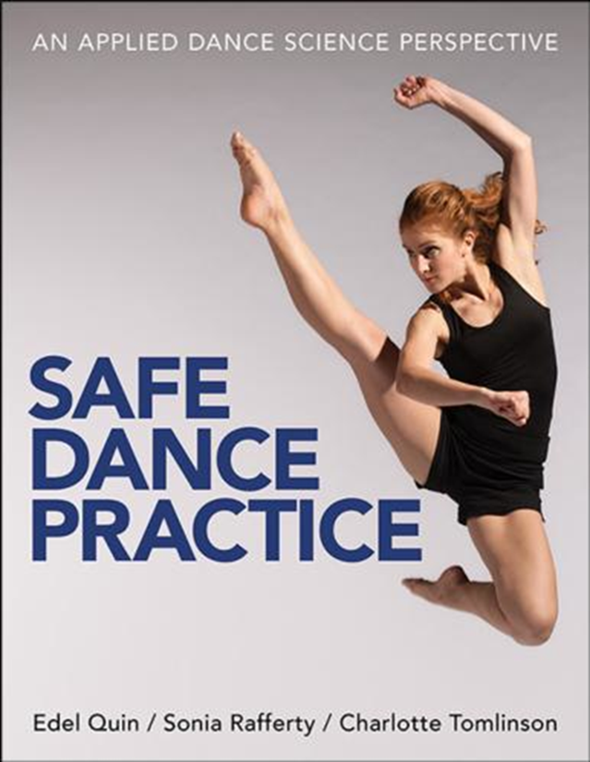
Any questions??
Charlotte.Tomlinson@hotmail.com
Twitter - @fit4dancect
Facebook – Fit Dance
www.fit4dance.com

